Slide 1
MODULE 4
Support for Object Oriented Programming

Slide 2
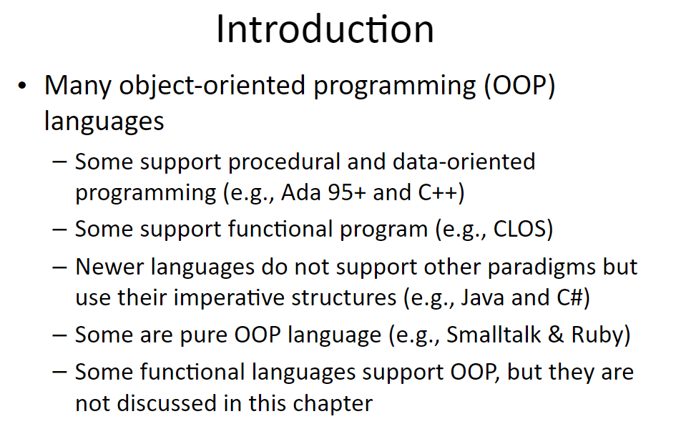

Slide 3
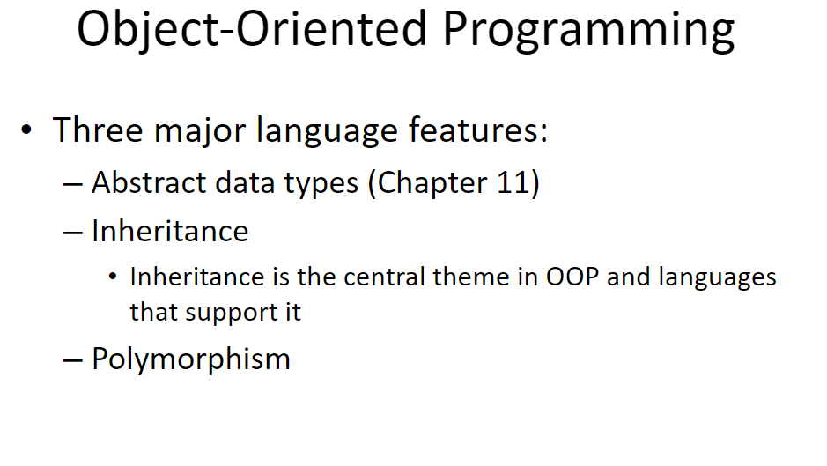

Slide 5
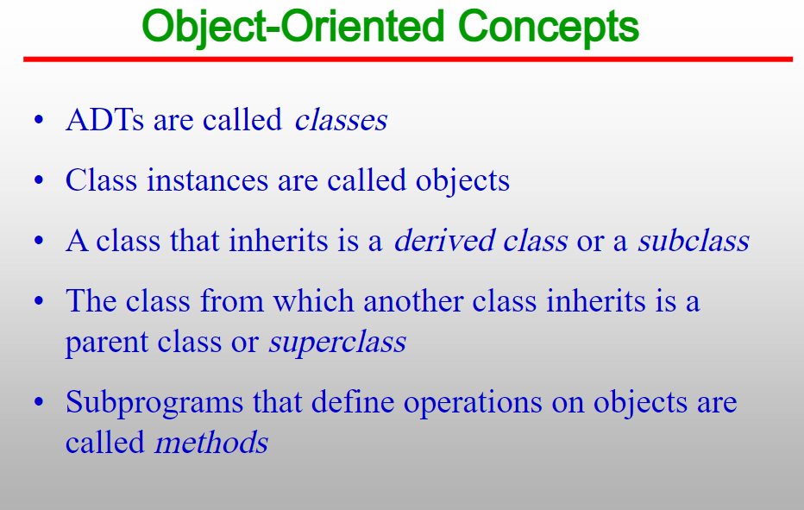
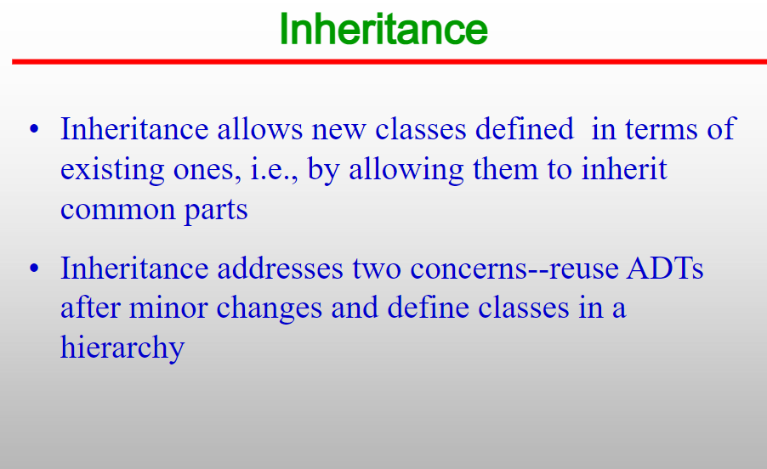
Inheritance

Slide 6


Slide 7
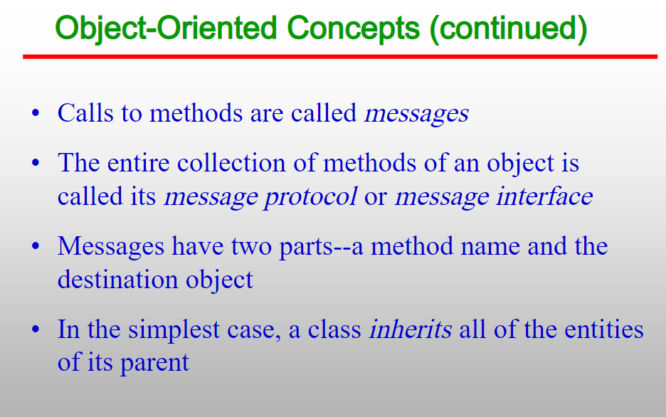


Slide 8
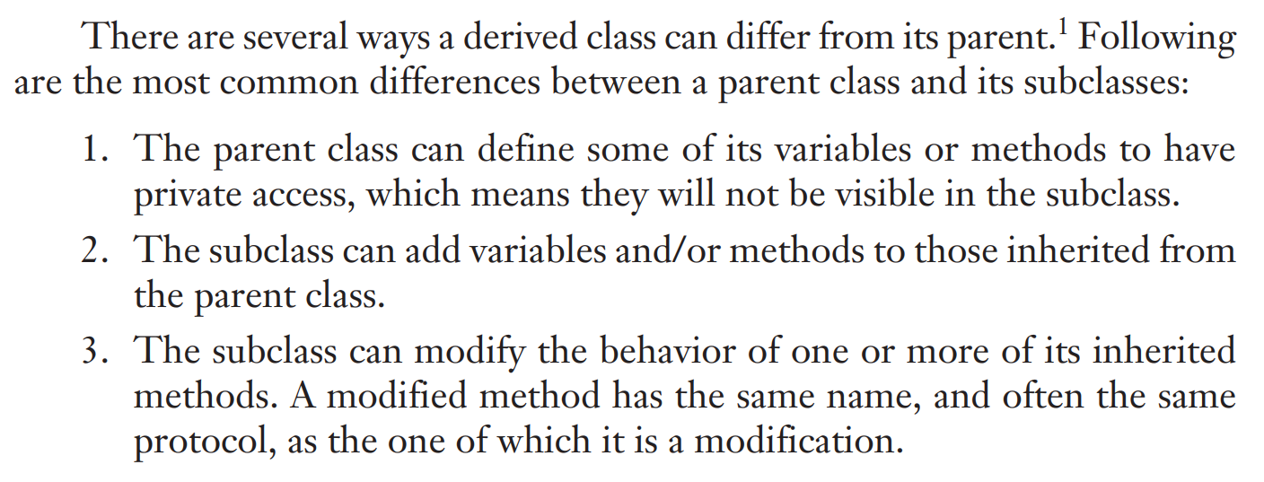


Slide 9
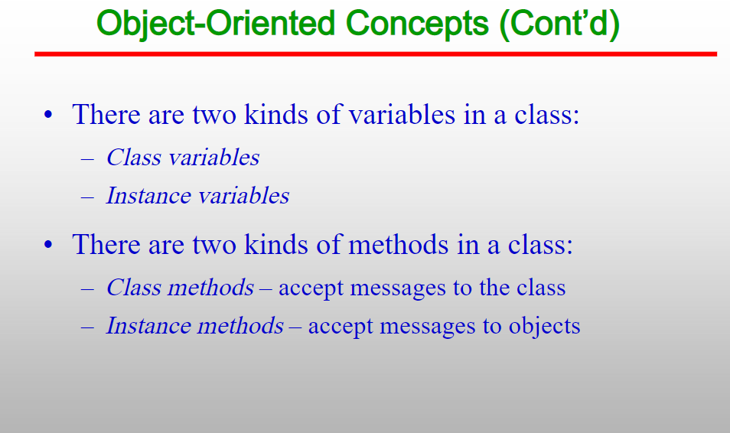

Slide 10
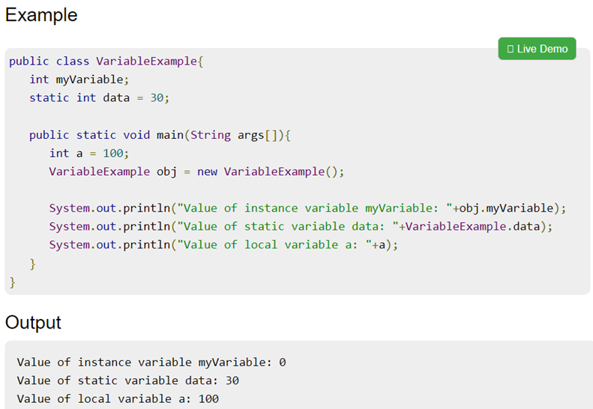

Slide 11
Inheritance
One disadvantage of inheritance as a means of increasing the possibility of reuse is that it creates dependencies among the classes in an inheritance hierarchy.
This result works against one of the advantages of abstract data types, which is that they are independent of each other.
Of course, not all abstract data types must be completely independent.
But in general, the independence of abstract data types is one of their strongest positive characteristics

Slide 12
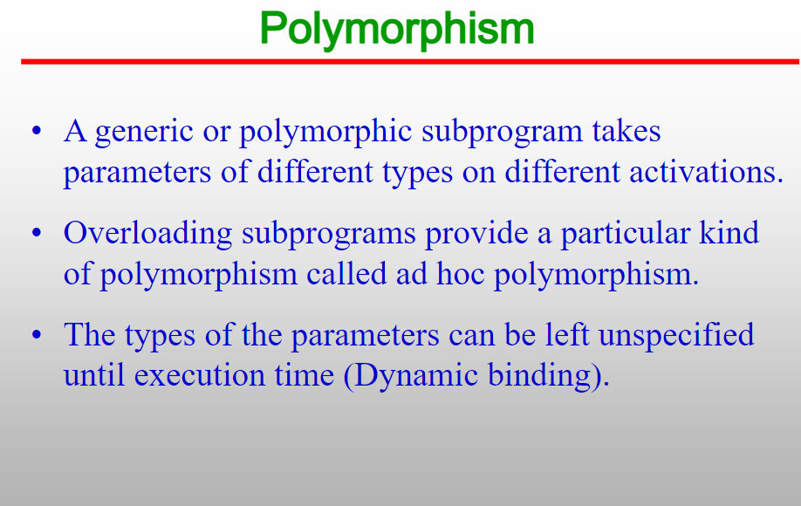

Slide 13
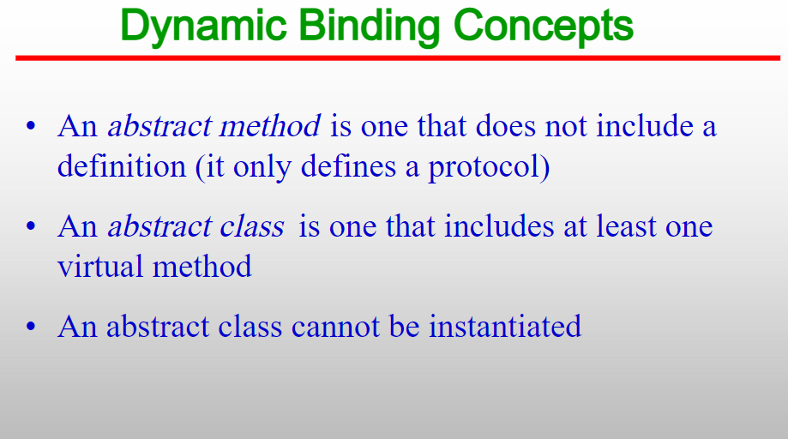

Slide 14
Pure Virtual Functions and Abstract Classes
Sometimes implementation of all function cannot be provided in a base class because we don’t know the implementation. Such a class is called abstract class.
For example, let Shape be a base class. We cannot provide implementation of function draw() in Shape, but we know every derived class must have implementation of draw().
Similarly an Animal class doesn’t have implementation of move() (assuming that all animals move), but all animals must know how to move. We cannot create objects of abstract classes.

Slide 15
A virtual function is a member function that is declared in the base class using the keyword virtual and is re-defined (Overridden) in the derived class.
It tells the compiler to perform late binding where the compiler matches the object with the right called function and executes it during the runtime.
This technique falls under Runtime Polymorphism.

Slide 16
Pure virtual functions are used
if a function doesn't have any use in the base class
but the function must be implemented by all its derived classes

Slide 17
For example,
Suppose, we have derived Triangle, Square and Circle classes from the Shape class, and we want to calculate the area of all these shapes.
In this case, we can create a pure virtual function named calculateArea() in the Shape. Since it's a pure virtual function, all derived classes Triangle, Square and Circle must include the calculateArea() function with implementation.
A pure virtual function doesn't have the function body and it must end with = 0. For example,

Slide 18
Example
class Shape {
public:
// creating a pure virtual function
virtual void calculateArea() = 0;
};

Slide 19
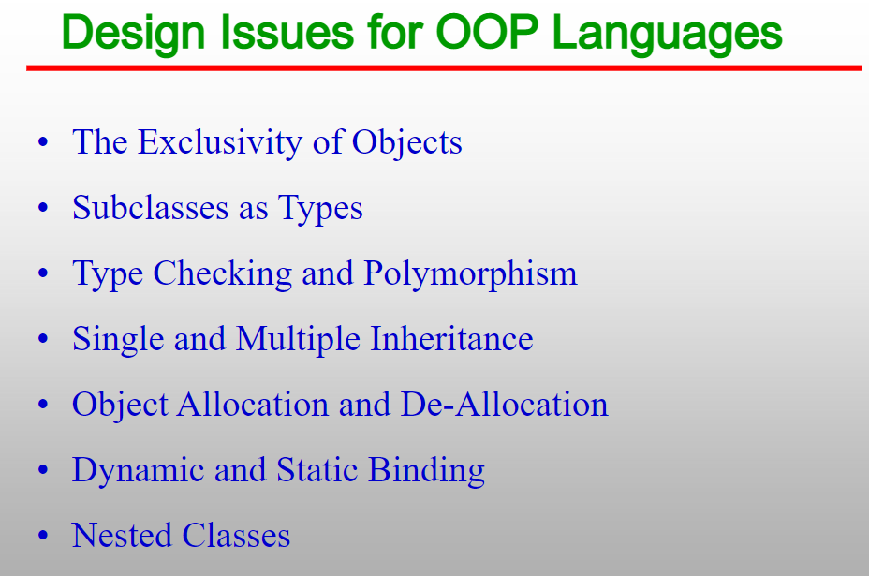


Slide 20
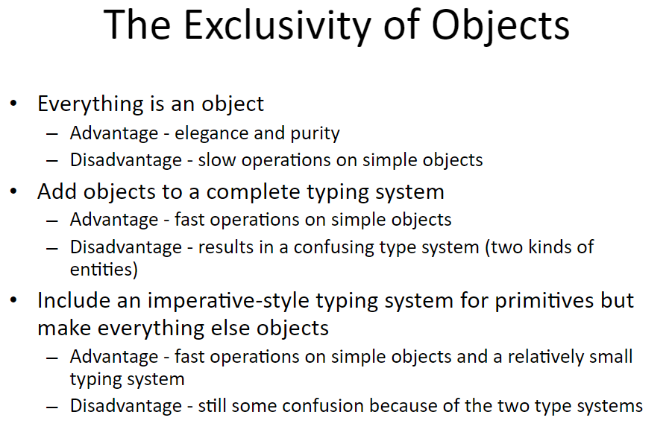

Slide 21
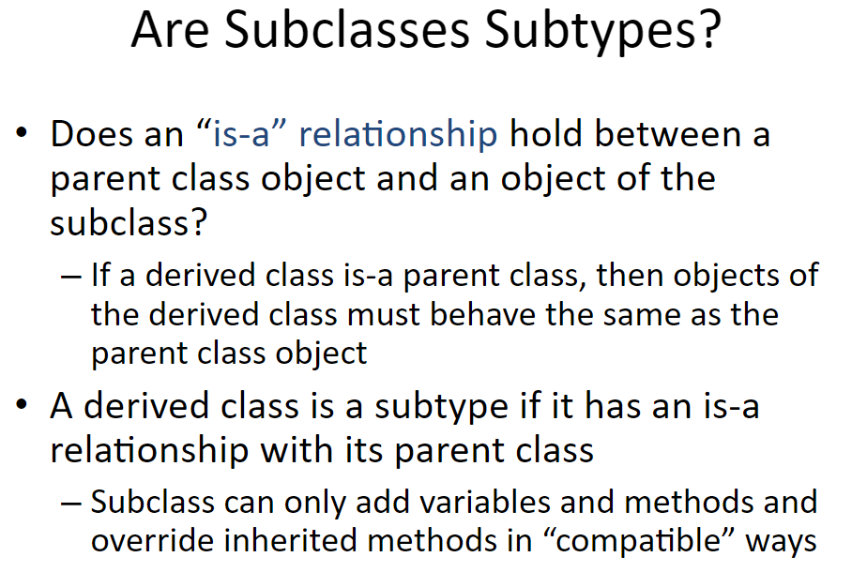
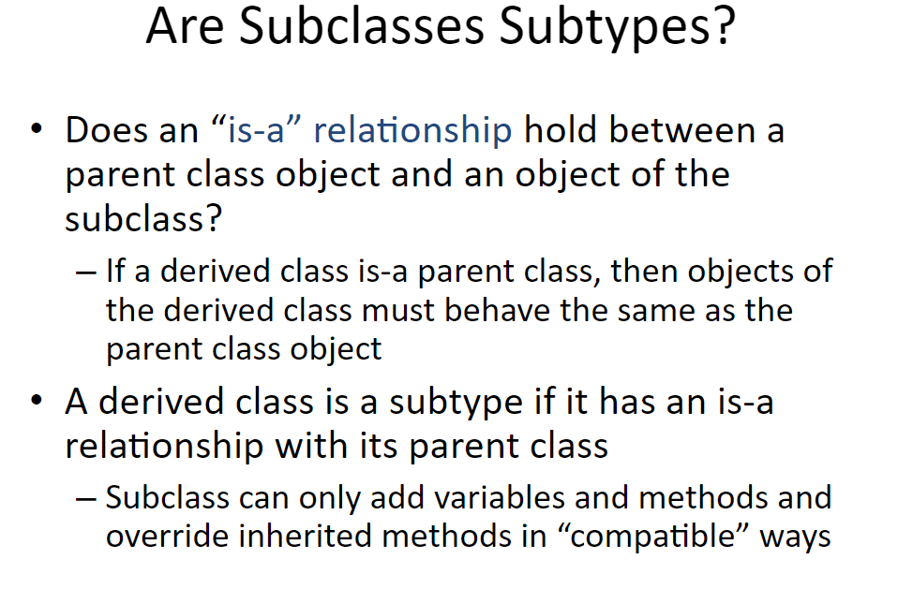

Slide 22
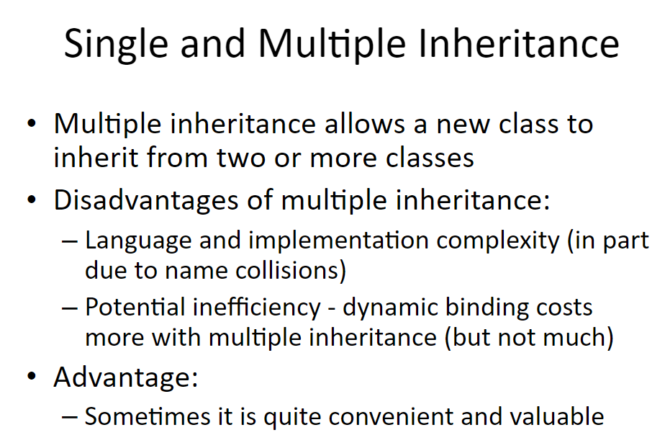

Slide 23
Problem 1
If a class has two unrelated parent classes and neither defines a name that is defined in the other, there is no problem.
However, suppose a subclass named C inherits from both class A and class B and both A and B define an inheritable method named display.
If C needs to reference both versions of display, how can that be done
This ambiguity problem is further complicated when the two parent classes both define identically named methods and one or both of them must be overridden in the subclass

Slide 24
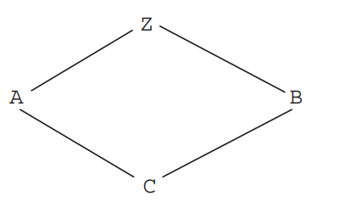
Another issue arises if both A and B are derived from a common parent, Z, and C has both A and B as parent classes.
This situation is called diamond or shared inheritance.
In this case, both A and B should include Z’s inheritable variables. Suppose Z includes an inheritable variable named sum.
The question is whether C should inherit both versions of sum or just one, and if just one, which one?

Slide 25
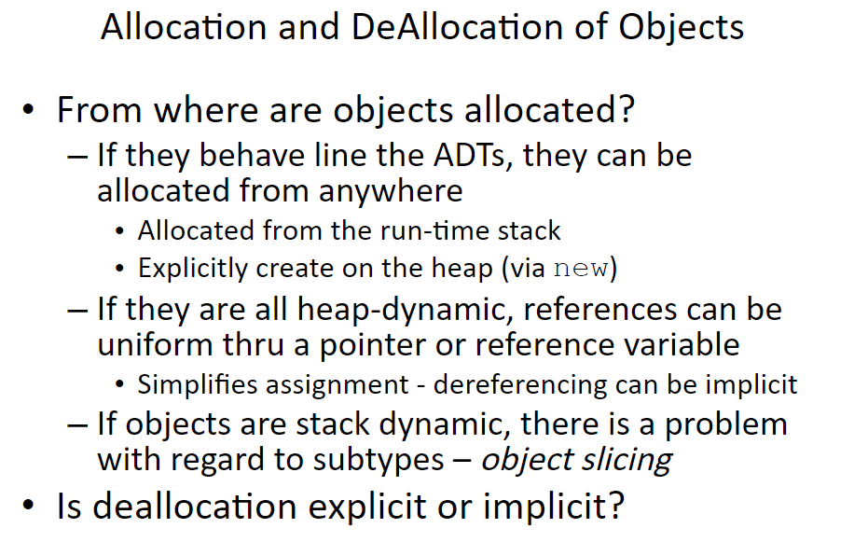

Slide 26
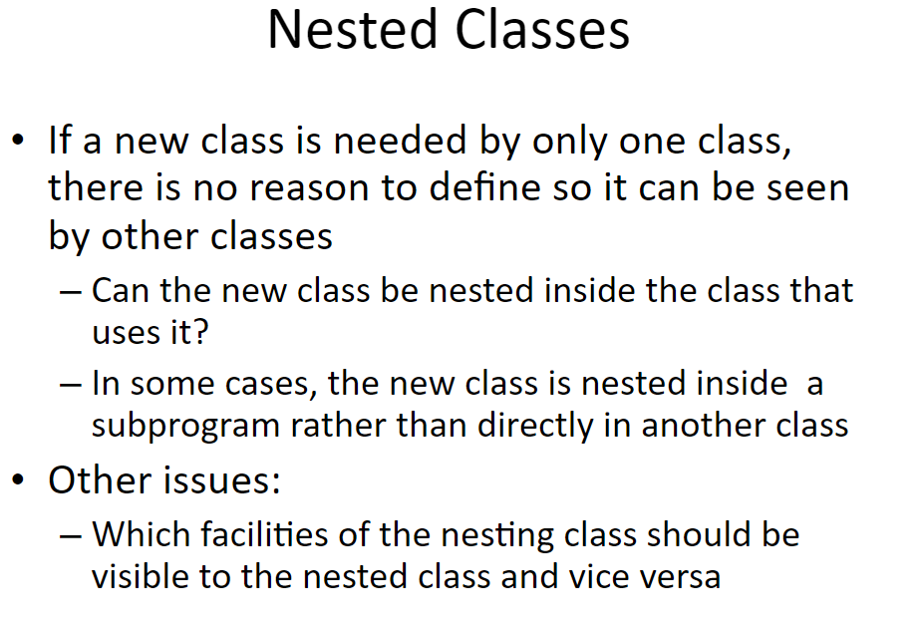

Slide 27
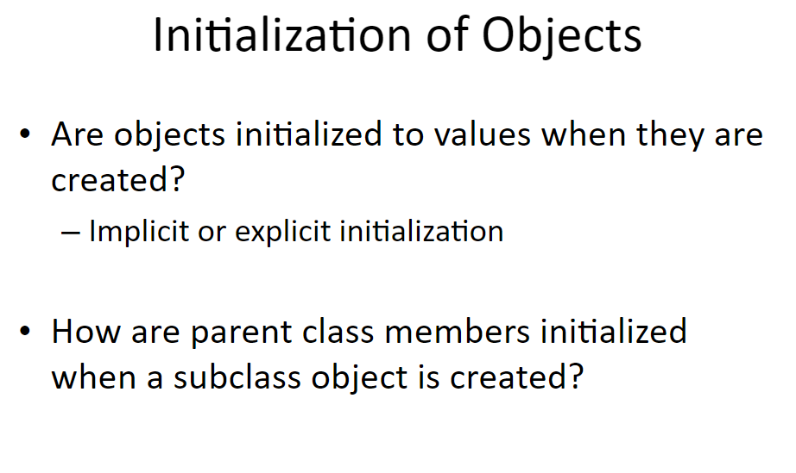

Slide 28
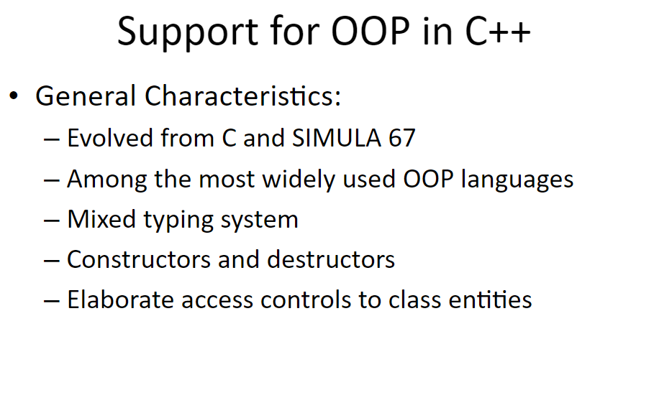

Slide 29
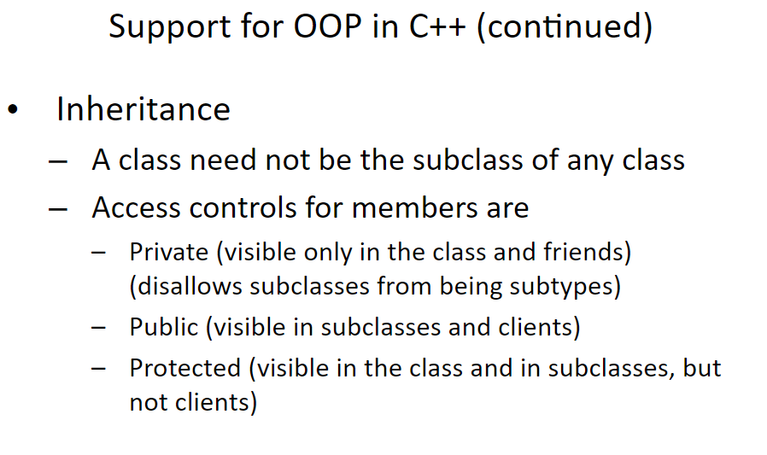

Slide 30
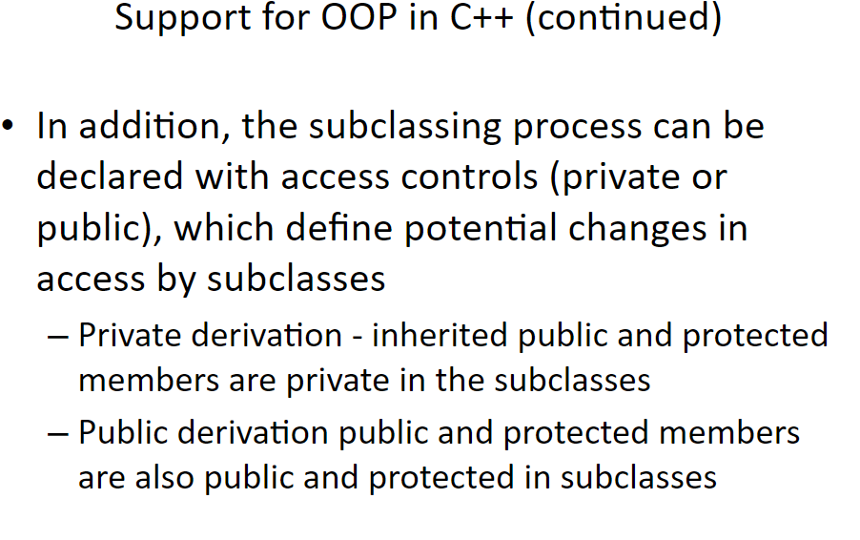

Slide 31
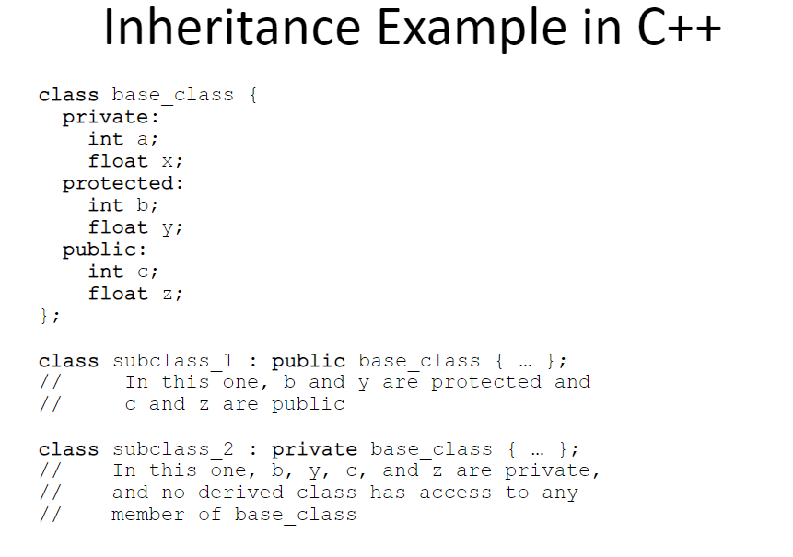

Slide 32
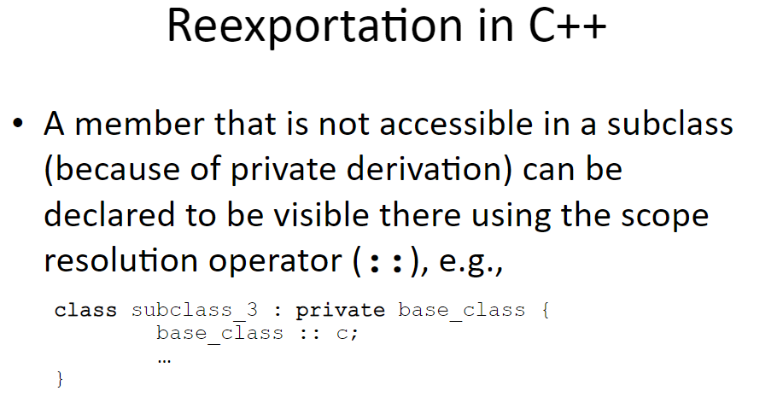

Slide 34
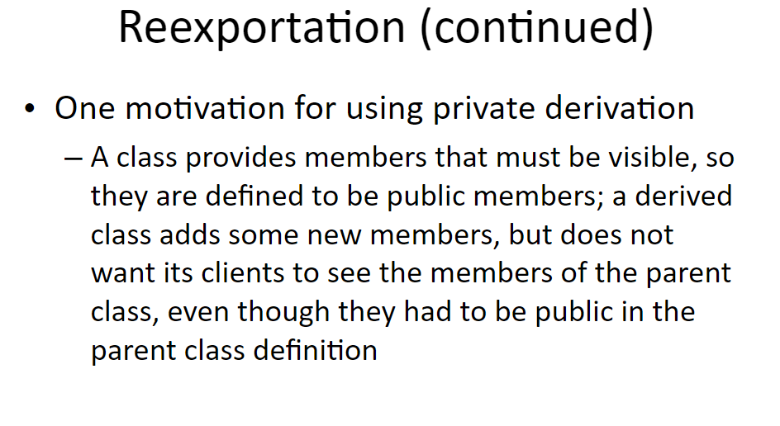

Slide 35
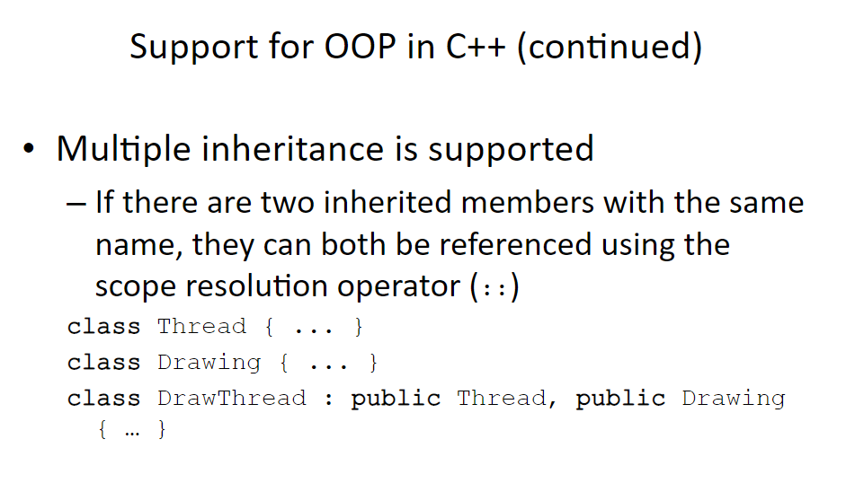

Slide 36
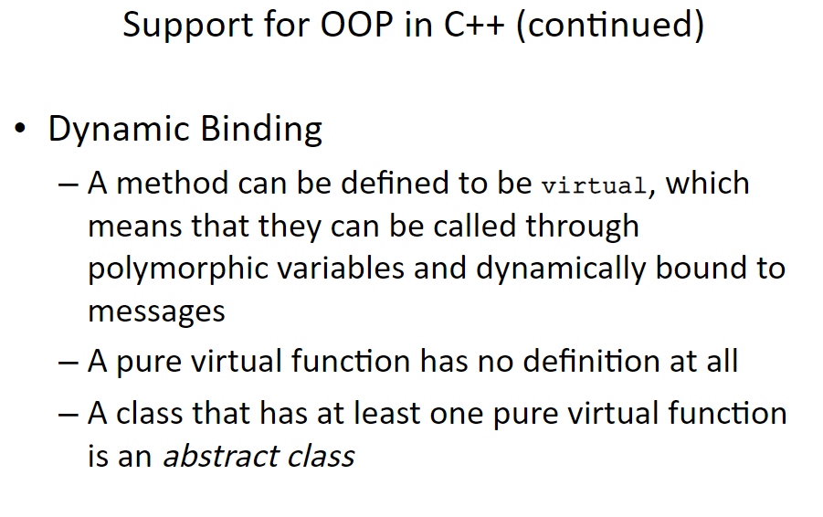

Slide 37
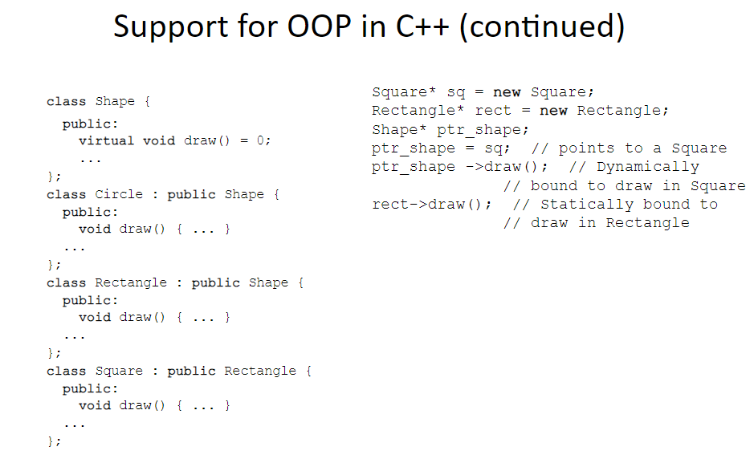

Slide 38
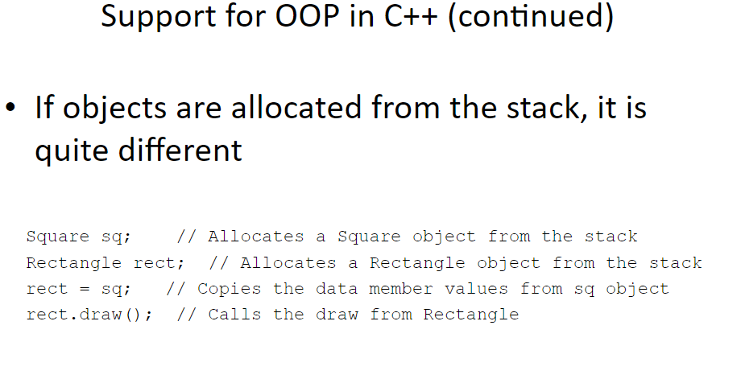

Slide 39
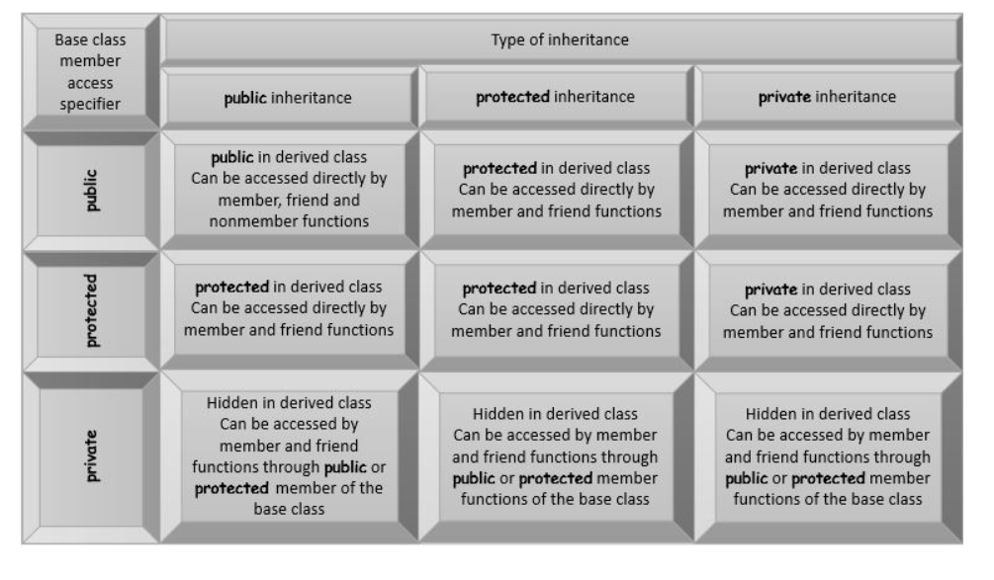

Slide 40
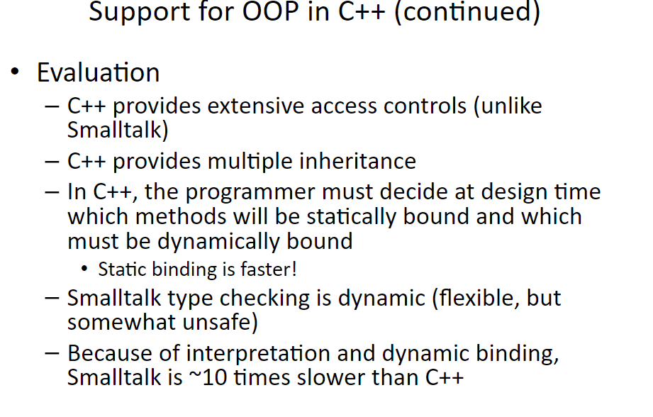

Slide 41
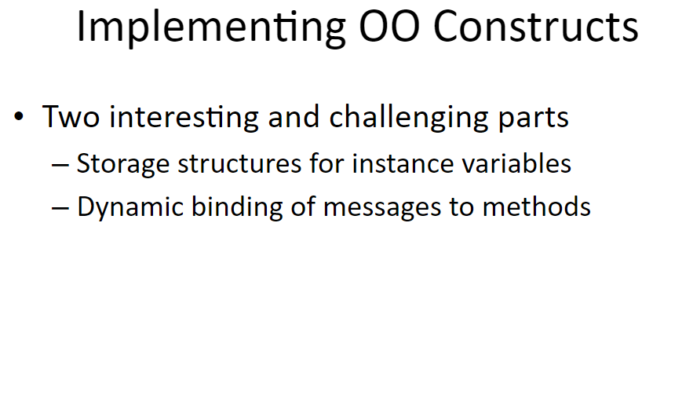

Slide 42
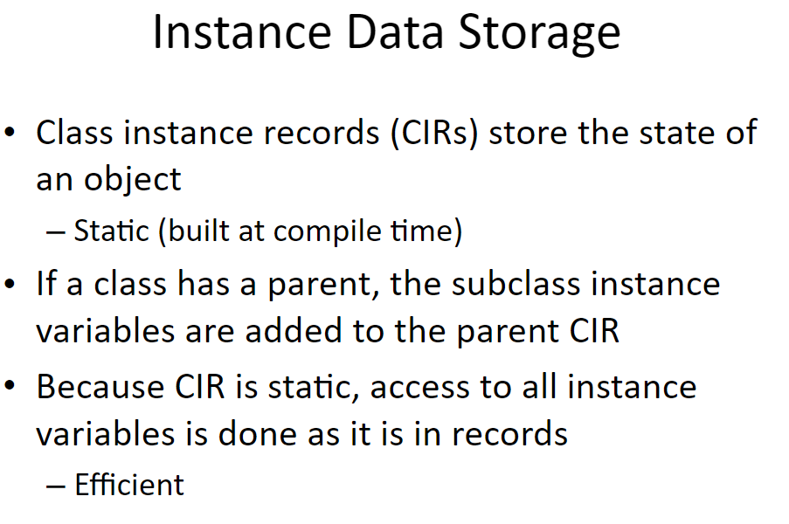

Slide 43
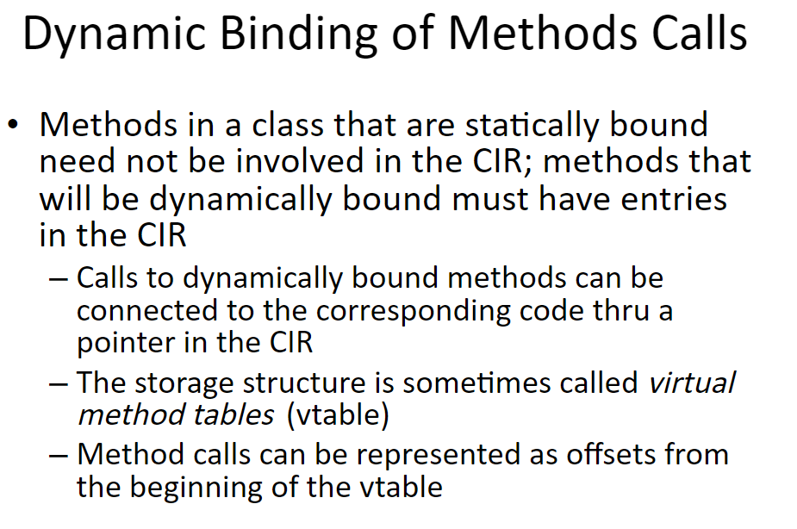

Slide 44
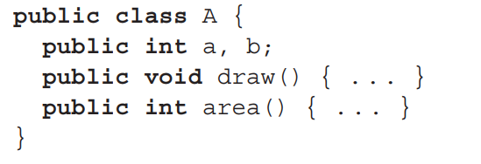
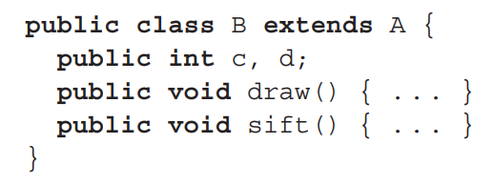
Example

Slide 45
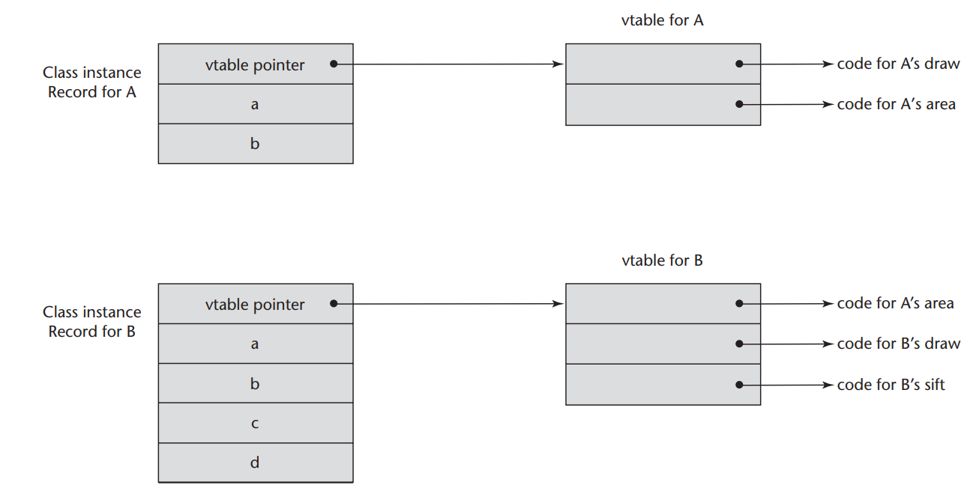

Slide 46
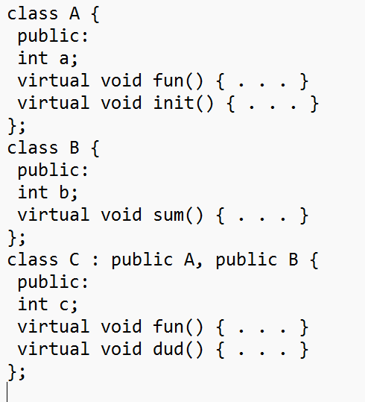
Multiple Inheritance

Slide 47
